Slide 1

Agent Activity Chart
8/12/2022 6:13 AM
Print User : automation
Page 1 of 3

Slide 2
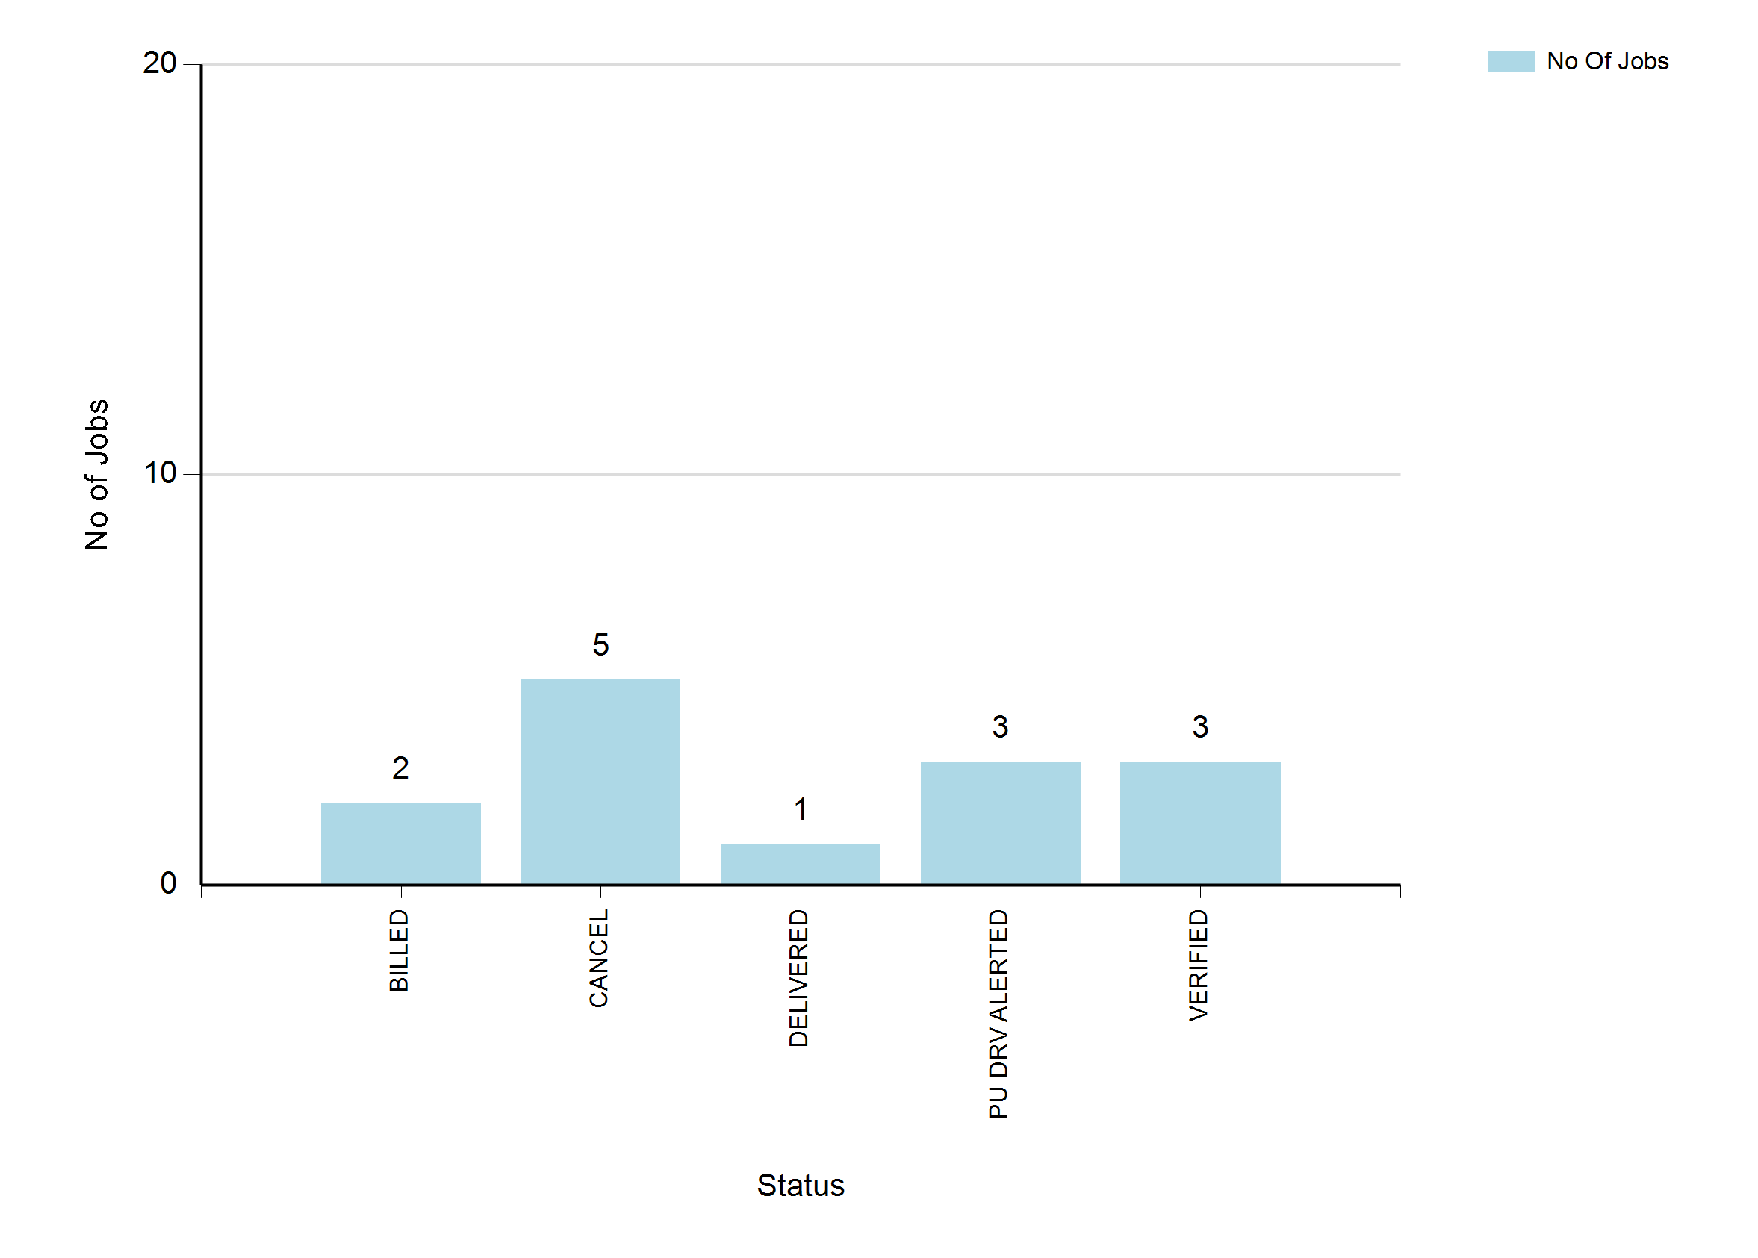
8/12/2022 6:13 AM
Print User : automation
Page 2 of 3

Slide 3
8/12/2022 6:13 AM
Print User : automation
Page 3 of 3

